Slide 1
BRAIN TUMOR CLASSIFICATION SYSTEM
Prepared by: Team 1

Slide 2
TEAM MEMBERS
Abdullah Yasser
Fady Bekheet
Gerges Marzouk
Hussein Ebrahim
Mazen Omar

Slide 3
TABLE OF CONTENTS
01
INTRODUCTION
03
MODEL
02
04
DATA
RESULTS
What is the focus of this project
Model architecture and training
Dataset and data preprocessing
Evaluation metrics and visualization

Slide 4
01
INTRODUCTION

Slide 5
PROBLEM STATEMENT
There is a need for an automated system that accurately classifies brain tumors from MRI images to support faster and more reliable diagnosis.

Slide 6
THE ISSUE AT HAND
Brain tumors require early and accurate diagnosis to improve patient outcomes, and MRI scans are widely used because they provide detailed images of the brain.
However, manually analyzing these scans is time-consuming and depends on the radiologist’s experience, which can lead to delays or inconsistent results.
With the growing number of medical images, this process has become even more challenging.

Slide 7
THE SOLUTION
Therefore, an automated brain tumor classification system using modern image processing and deep learning techniques is needed to analyze MRI images more efficiently, reduce errors, and assist doctors in making better treatment decisions.
The next few slides outline our attempt at producing an automated system that accurately classifies brain tumors from MRI images to support faster and more reliable diagnosis.

Slide 8
02
DATA

Slide 9
DATASET USED
The name of the dataset is Brain Tumor MRI Images 44 Classes. It is a collection of T1, contrast-enhanced T1, and T2 MRI images of brain tumor.
The dataset consists of images without any type of marking or patient identification, interpreted by radiologists and provided for study purposes.
Includes 14 types of brain tumors.
Dataset Link: https://www.kaggle.com/datasets/fernando2rad/brain-tumor-mri-images-44c/data

Slide 10
DATASET USED
The dataset included 15 classes;
Astrocytoma
Carcinoma
Ependymoma
Ganglioglioma
Germinoma
Glioblastoma
Granuloma
Medulloblastoma
Meningioma
Neurocytoma
Oligodendroglioma
Papilloma
Schwannoma
Tuberculoma
Normal

Slide 11
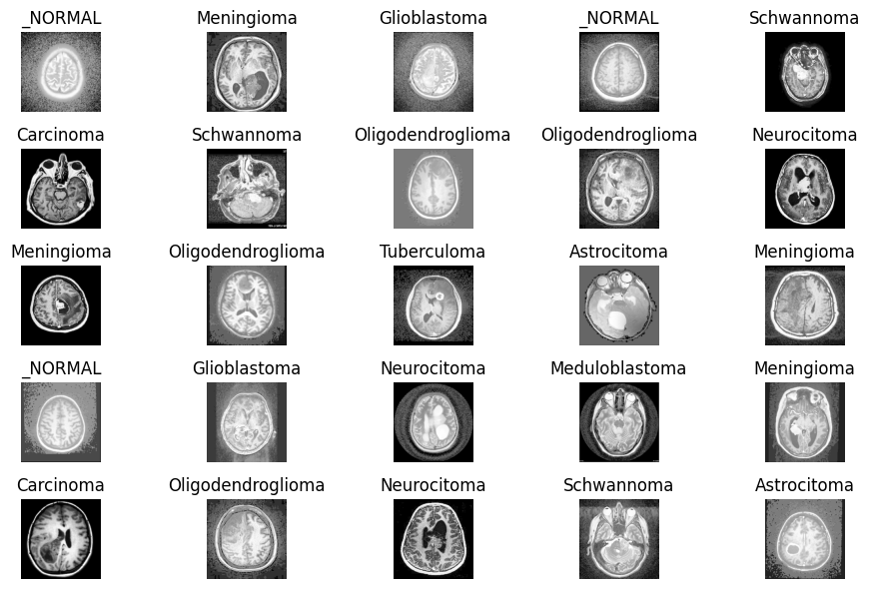
DATASET SAMPLES

Slide 12
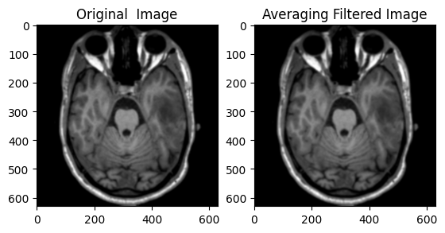
IMAGE PROCESSING
Averaging Filter

Slide 13

IMAGE PROCESSING
Median Filter

Slide 14

IMAGE PROCESSING
Gaussian Filter

Slide 15
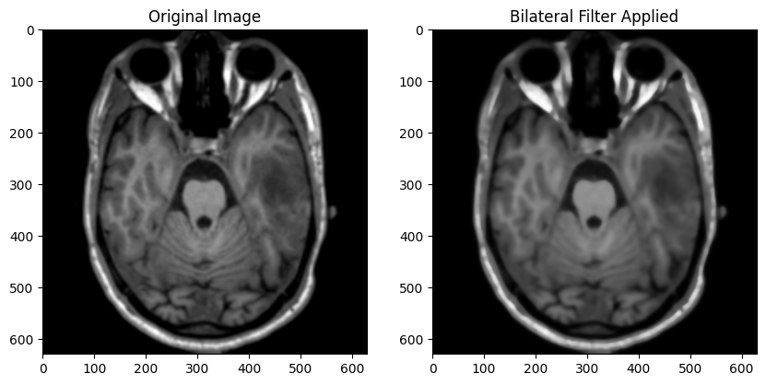
IMAGE PROCESSING
Bilateral Filter

Slide 16
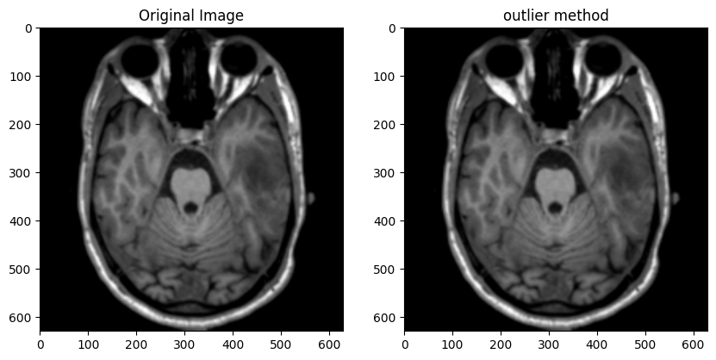
IMAGE PROCESSING
Outlier Method

Slide 17
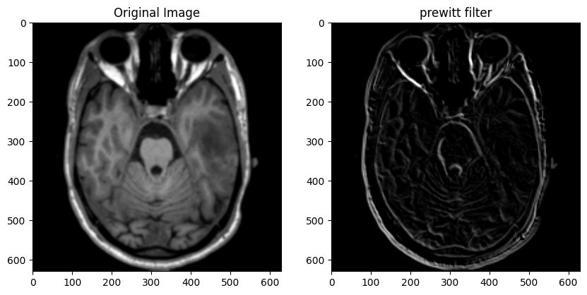
IMAGE PROCESSING
Prewitt Filter

Slide 18
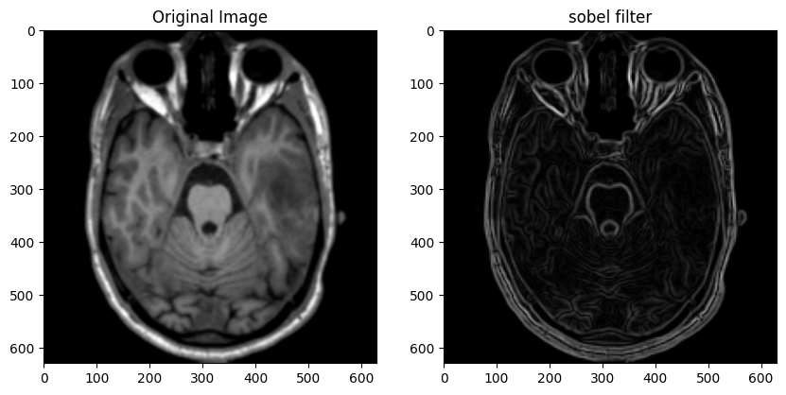
IMAGE PROCESSING
Sobel Filter

Slide 19
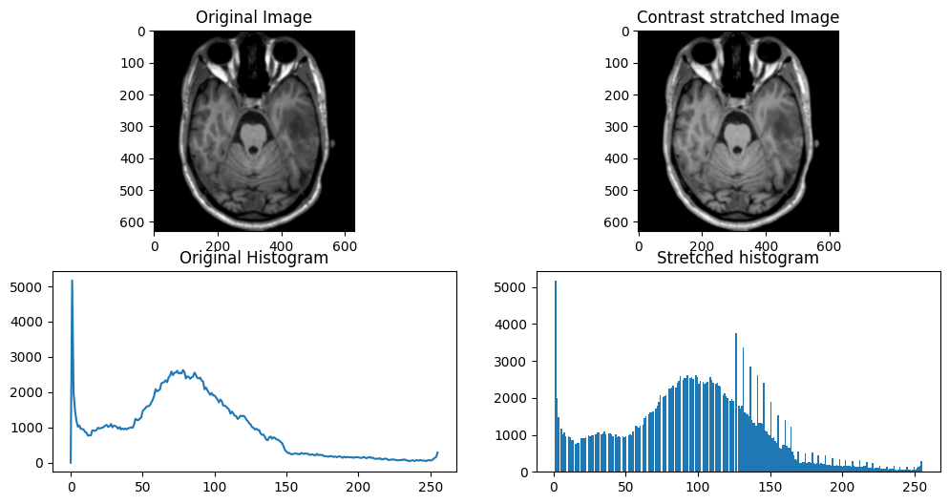
IMAGE PROCESSING
Contrast Stretching

Slide 20
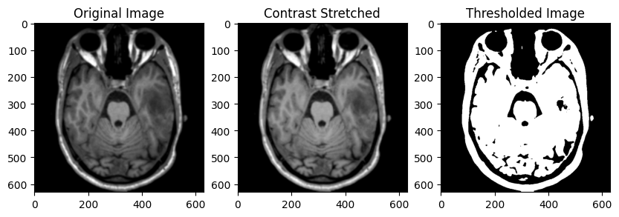
IMAGE PROCESSING
Thresholding

Slide 21
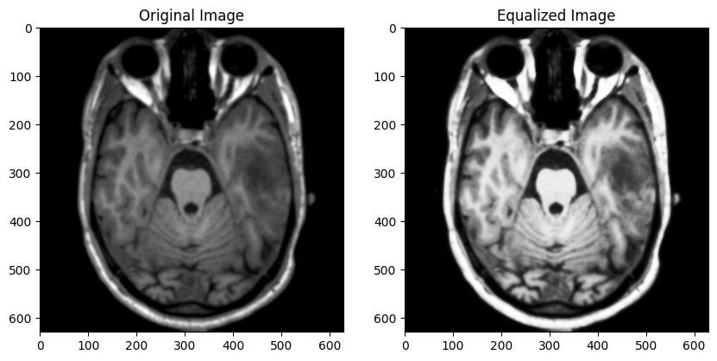
IMAGE PROCESSING
Histogram Equalization

Slide 22
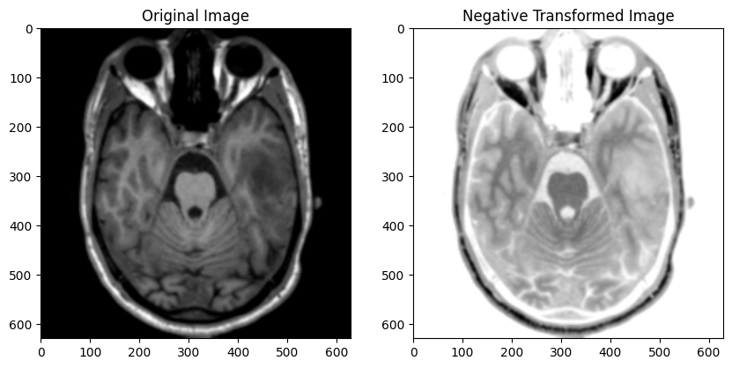
IMAGE PROCESSING
Negative Transformation

Slide 23
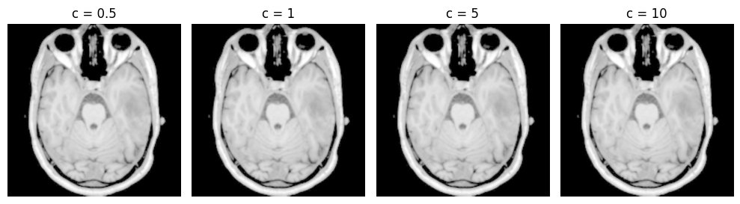
IMAGE PROCESSING
Logarithmic Transformation

Slide 24
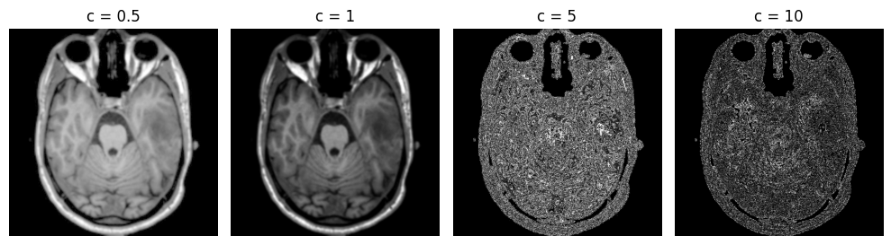
IMAGE PROCESSING
Gamma Transformation

Slide 25
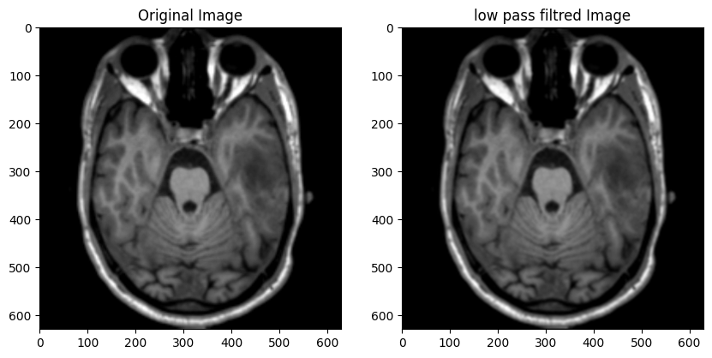
IMAGE PROCESSING
Low Pass Filtering

Slide 26
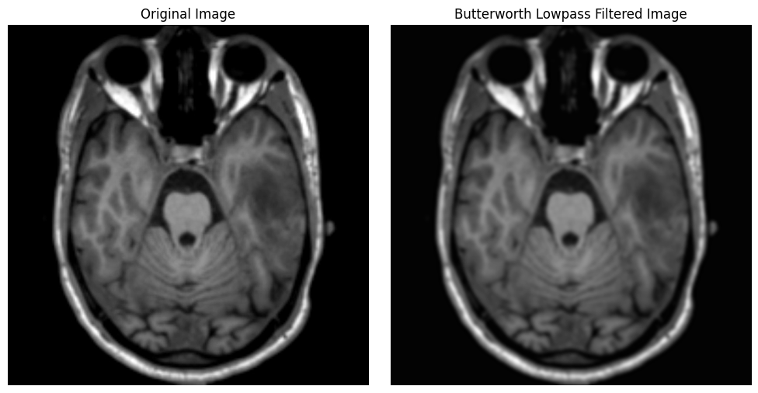
IMAGE PROCESSING
Butterworth Lowpass Filtering

Slide 27
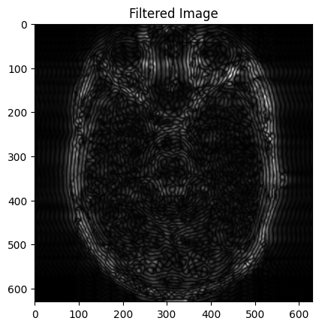
IMAGE PROCESSING
High Pass Filter

Slide 28
IMAGE PROCESSING
Butterworth Lowpass Filtering

Slide 29
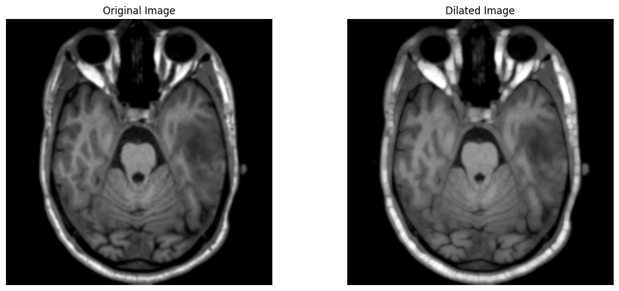
IMAGE PROCESSING
Dilation Filter

Slide 30
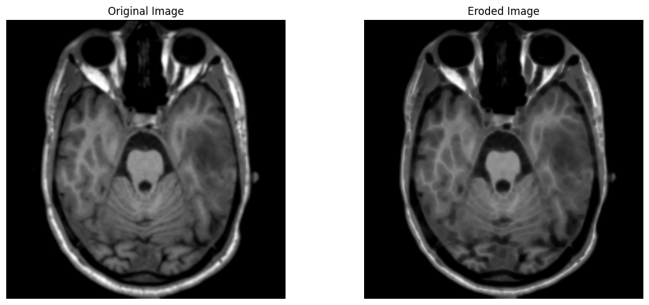
IMAGE PROCESSING
Erosion Filter

Slide 31
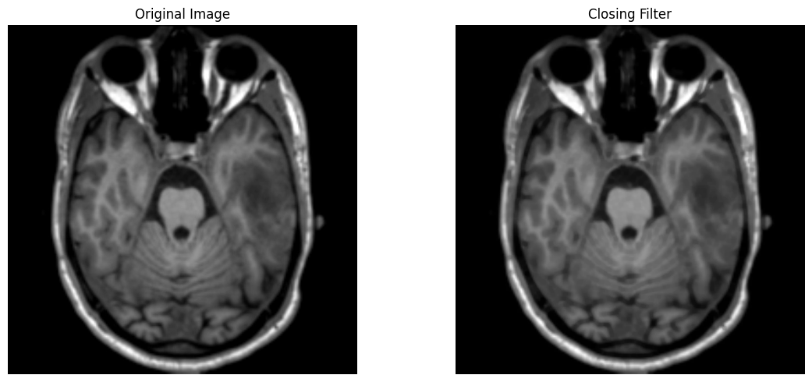
IMAGE PROCESSING
Closing Filter

Slide 32

IMAGE PROCESSING
Opening Filter

Slide 33
PRE-PROCESSING
Histogram Equalization provided the most satisfying result.
The dataset was turned into a Data Frame and histogram equalization was performed on the entire Data Frame.

Slide 34
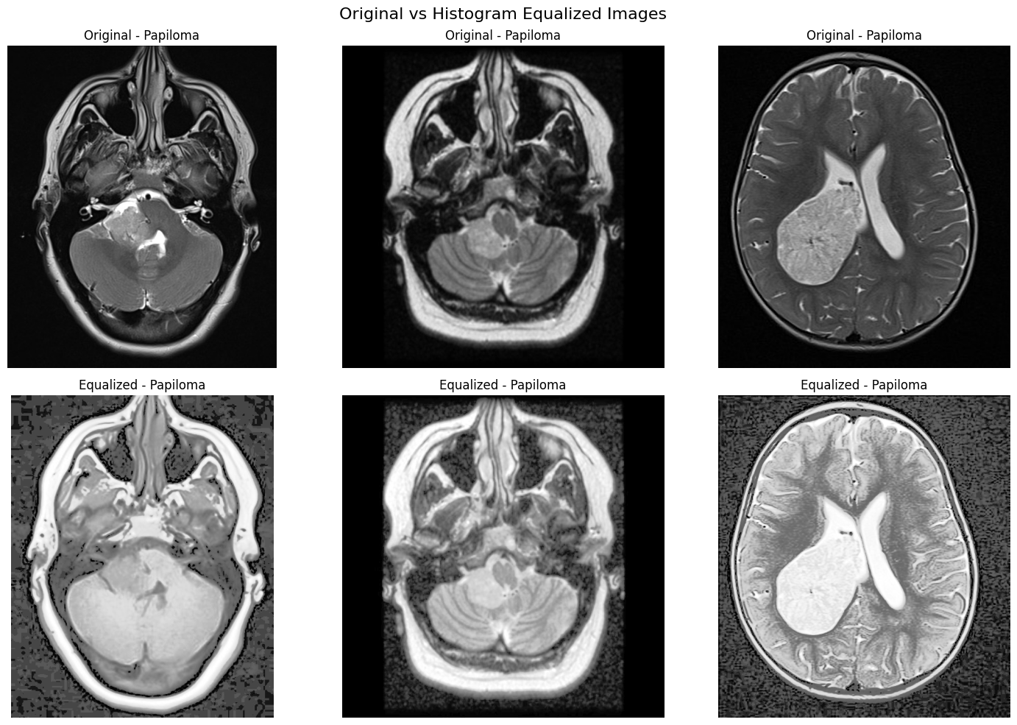
PRE-PROCESSING
Samples of preprocessed data

Slide 35
03
MODEL

Slide 36
MODEL SELECTION
To perform deep learning on medical imagery as intricate as brain MRIs, the most details have to be preserved.
Dense Neural Networks flatten images first which makes them lose details.
However, CNNs work by moving a filter across the image, ensuring that as much detail as possible is considered.
EfficientNetB5 is one such CNN.

Slide 37
LOADING MODEL
EfficientNetB5 is a pretrained model so transfer learning is applied to the model by training it on the brain MRI images.
However, this meant that the original classes had to be removed while retaining the weights by using;
Include_top=False
weights='imagenet’,

Slide 38
ALTERING MODEL
Three layers were added;
Flatten Layer to turn data into 1D vector for dense layers.
Dense layer, 256 nodes with activation relu
Dense layer, 15 nodes the classification layer, activation function is softmax.
Batch Normalization is used as well as a dropout rate of 0.45 to prevent the model from depending on some nodes.
Adam optimizer is used and Categorical Crossentropy Loss function is used.

Slide 39
CALLBACKS
While accuracy is below 90%, the callback prioritizes Training Accuracy. Once the model hits 90% accuracy, the priority shifts to Validation Loss.
If the metric (Accuracy or Validation Loss) doesn't improve for a set number of epochs the callback assumes the model is stuck and reduces the learning rate by half.
Best weights are saved to prevent any late overfitting.

Slide 40
04
RESULTS

Slide 41
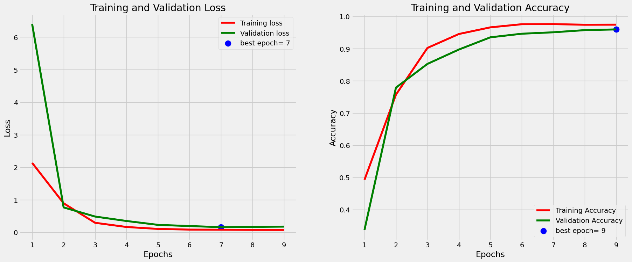
LOSS AND ACCURACY CURVES

Slide 42
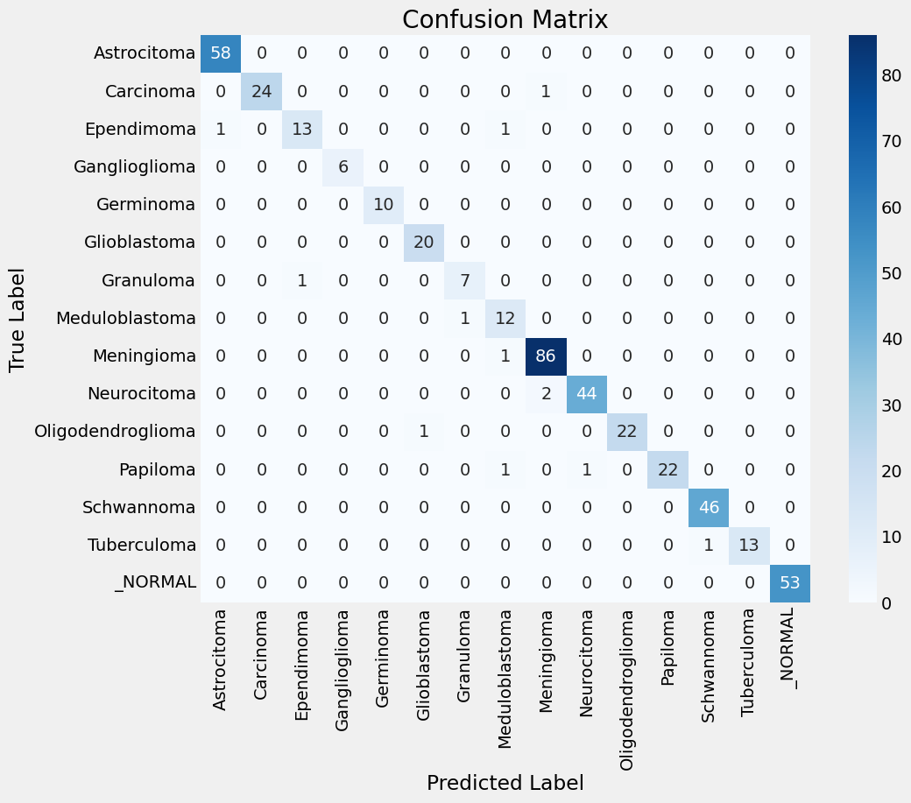
CONFUSION MATRIX

Slide 43
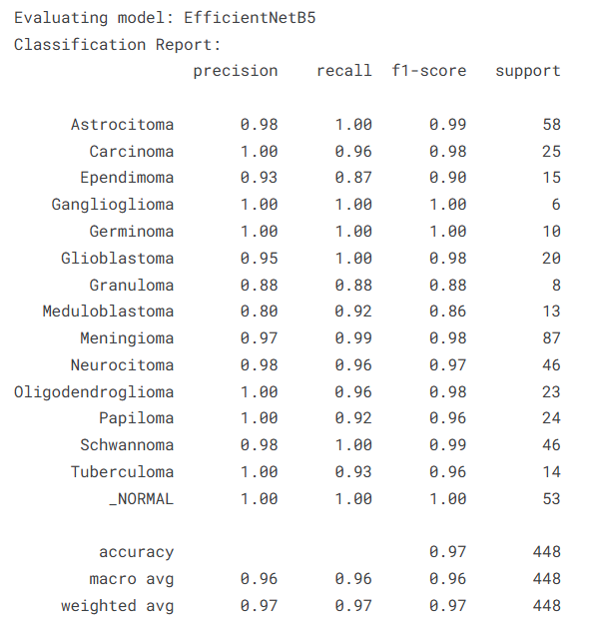
CLASSIFICATION REPORT

Slide 44
References
Automated multi-class MRI brain tumor classification and segmentation using deformable attention and saliency mapping | Scientific Reports
Brain Tumor Detection and Prediction in MRI Images Utilizing a Fine-Tuned Transfer Learning Model Integrated Within Deep Learning Frameworks

Slide 45
THANK YOU
Project Link:
https://github.com/fady-bakheet/Brain-Tumor-MRI-Classification/tree/main

